Slide 1

BRENT’S OIL PRICE PREDICTION
This Photo by Unknown Author is licensed under CC BY-NC

Slide 2




CONTENTS
CONTENTS

Slide 3
DATA DESCRIPTION
8216 observations & 2 Variables (‘Year’ & ‘Price’
Oil Price of from years 1987-2019

Slide 4
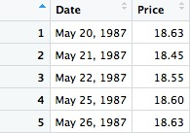
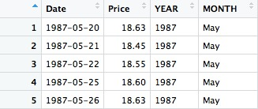

EDA
DATA CLEANING & MODIFICATION
Converted Date column to 'date' format from 'chr' format.
Extracted 'Year' & 'Month' columns to find predictions on yearly and monthly basis.

Slide 5
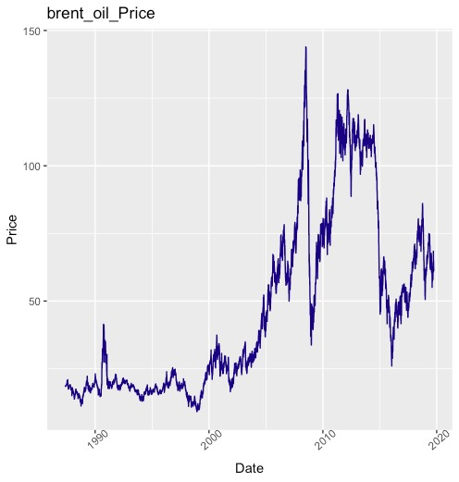
EDA CONTD.
Data showing increasing Trend over time.
No seasonality.

Slide 6
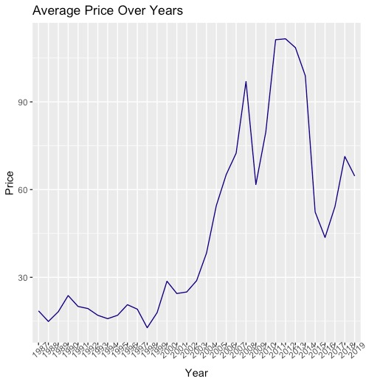
EDA CONTD.
Years 1987-2001 show slight change in average price.
Sudden increase in average price from 2001-2019.
Will predict future prices on yearly basis.

Slide 7
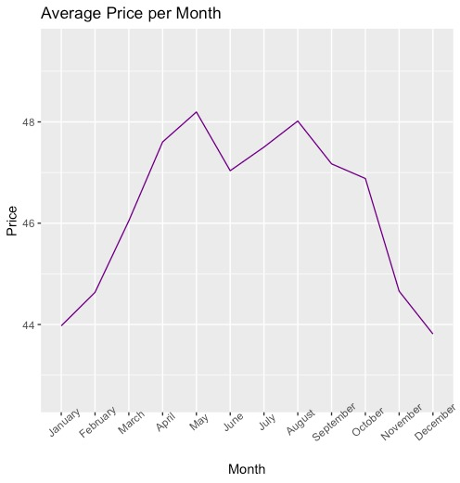
EDA CONTD.
Costly months → April – October.
Will predict future prices on monthly basis

Slide 8
FORECASTING /PREDICTION
SIMPLE FORECASING METHODS (SFM)
Average Method:
Forecasts of all future values are equal to the mean of the historical data.
Naïve Method:
All forecasts are set to the last observation
Seasonal Naïve Method:
Forecasts last observed value for the same season
Drift Method:
Forecasts value by adding amount of change over time

Slide 9
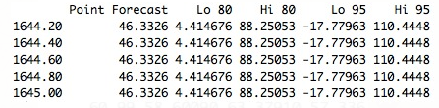
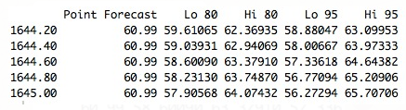
FORECASTING /PREDICTION
Weekly Predictions using SMF
Average Method →
Naïve Method→

Slide 10
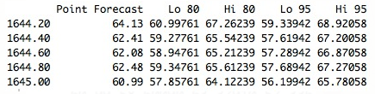
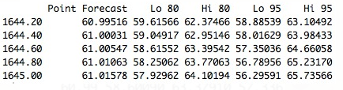
FORECASTING /PREDICTION
Weekly Predictions using SMF
Seasonal Naïve →
Drift Method→

Slide 11
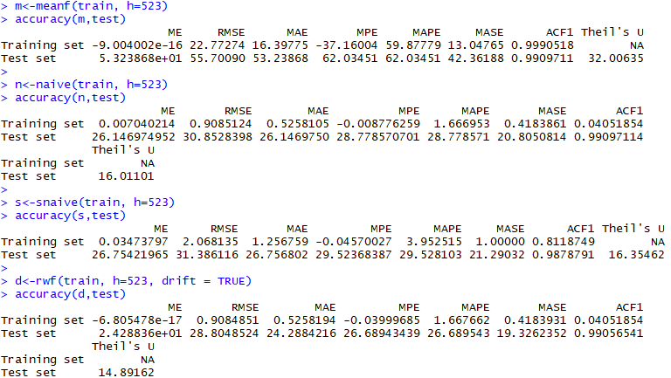
Test of Accuracy Measures
Best Model: Drift Method

Slide 12
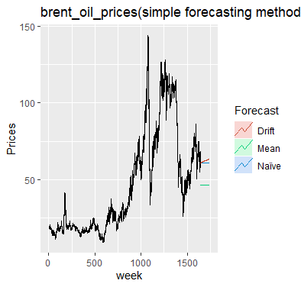
VISUALIZING SIMPLE FORECASTING METHODS

Slide 13
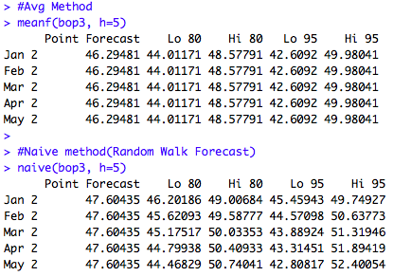
FORECASTING /PREDICTION
Monthly Predictions using SMF
Average Method →
Naïve Method→

Slide 14
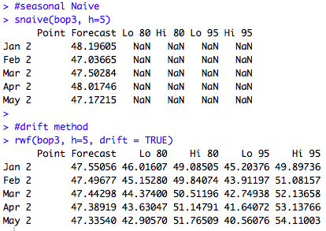
FORECASTING /PREDICTION
Monthly Predictions using SMF
Seasonal Naïve →
Drift Method→

Slide 15
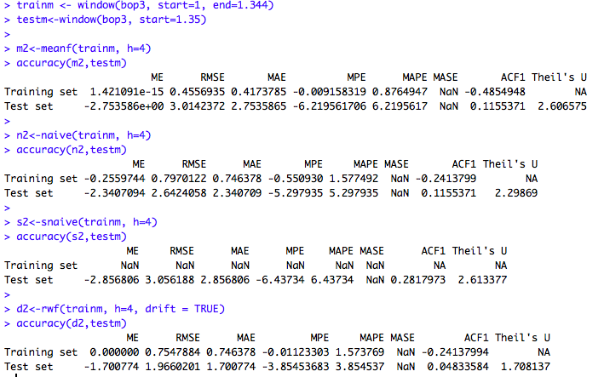
Test of Accuracy Measures
Best Model: Drift Method

Slide 16
VISUALIZING SIMPLE FORECASTING METHODS

Slide 17
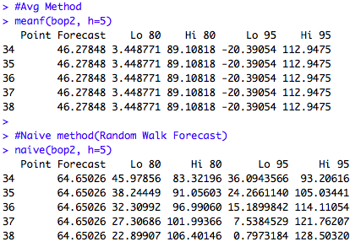
FORECASTING /PREDICTION
Yearly Predictions using SMF
Average Method →
Naïve Method→

Slide 18
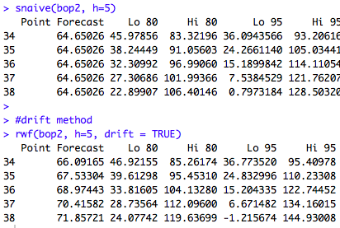
FORECASTING /PREDICTION
Yearly Predictions using SMF
Seasonal Naïve →
Drift Method→

Slide 19
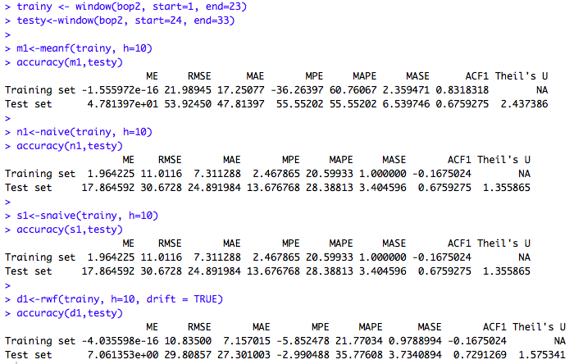
Test of Accuracy Measures
Best Model: Drift Method

Slide 20
VISUALIZING SIMPLE FORECASTING METHODS

Slide 21
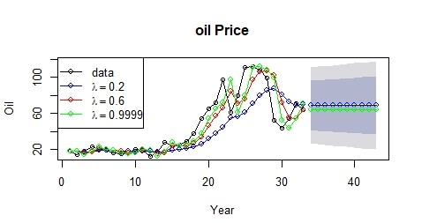
Single Exponential Smoothing

Slide 22
Single Exponential Smoothing, SES for short, also called Simple Exponential Smoothing, is a time series forecasting method for univariate data without a seasonality.
It requires a single parameter, called alpha (a), also called the smoothing factor or smoothing coefficient.
Alpha is often set to a value between 0 and 1. Large values mean that the model pays attention mainly to the most recent past observations, whereas smaller values mean more of the history is taken into account when making a prediction.
A value close to 1 indicates fast learning (that is, only the most recent values influence the forecasts), whereas a value close to 0 indicates slow learning (past observations have a large influence on forecasts).
The alpha value for this time series data forecast is 0.999 . Therefore, the most recent value influences the forecast.

Slide 23
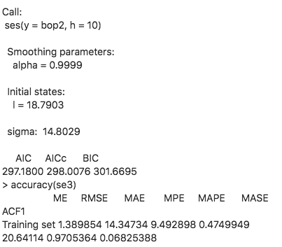

Slide 24
FORECASTING /PREDICTION
Holt’s Linear Trend Method:
Holt’s linear method is the extension of simple exponential smoothing, allowing forecasting of data with a trend.
It involves a forecast equation and two smoothing equations (one for the level and one for the trend).
Contains certain trend but no seasonality.

Slide 25
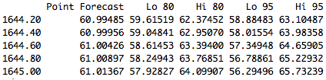
FORECASTING /PREDICTION
Weekly Predictions using Holt’s Linear Method

Slide 26
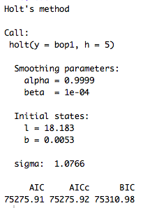
FORECASTING /PREDICTION
Summary of Model
ℓ𝑡 denotes an estimate of the level of the series at time 𝑡,
𝑏𝑡 denotes an estimate of the trend (slope) of the series at time 𝑡,
𝛼 is the smoothing parameter for the level, 0 ≤ 𝛼 ≤ 1, and
Lower the value of 𝛼 higher the smoothness.
Alpha controls the data smoothing. Bigger alpha gives more weight to recent data. Smaller alpha creates a smoother line.
𝛽 is the smoothing parameter for the trend, 0 ≤ 𝛽 ∗ ≤ 1.
Better trend if closer to 0
very small value means that the slope hardly changes over time
A non-zero beta accounts for trend. Bigger beta gives more weight to recent trend.

Slide 27
VISUALIZING HOLT’S LINEAR METHOD (WEEKLY)

Slide 28
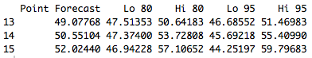
FORECASTING /PREDICTION
Monthly Predictions using Holt’s Linear Method

Slide 29
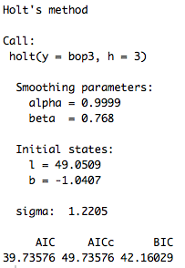
FORECASTING /PREDICTION
Summary of Model

Slide 30
VISUALIZING HOLT’S LINEAR METHOD (MONTHLY)

Slide 31
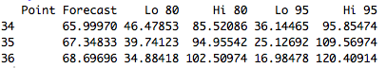
FORECASTING /PREDICTION
Yearly Predictions using Holt’s Linear Method

Slide 32
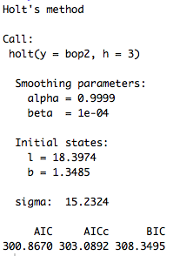
FORECASTING /PREDICTION
Summary of Model

Slide 33
VISUALIZING HOLT’S LINEAR METHOD (Yearly)

Slide 34
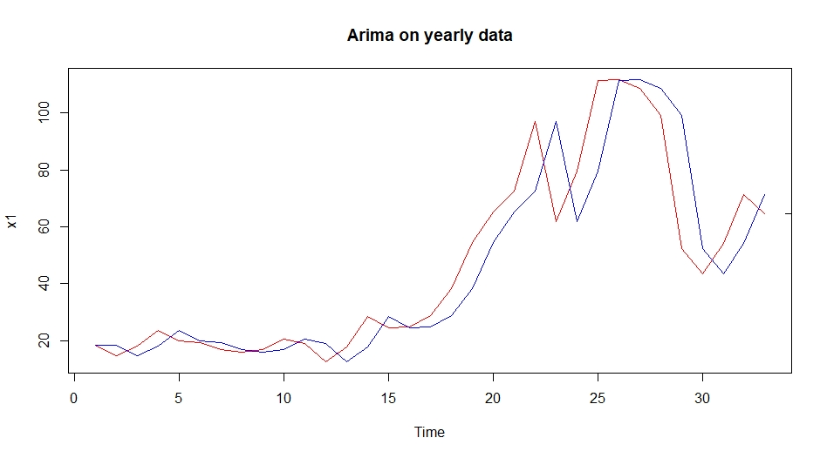
Arima models

Slide 35
ARIMA is an acronym for Auto Regressive Integrated Moving Average (in this context, “integration” is the reverse of differencing).
The function auto.arima() is useful, but anything automated is little too dangerous.
To overcome this we can use ggAcf and ggPacf can be used to determine the appropriate
values of p and q.
Above is the plot for yearly data and it better than monthly and weekly data.
The red one is the original data , blue line indicates fitted values and black one shows the predicted values.

Slide 36
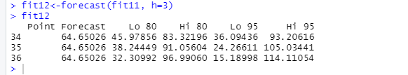
fit11
Series: bopyear ARIMA(0,1,0)
sigma^2 estimated as 212.3:
log likelihood=-131.13 AIC=264.26 AICc=264.4 BIC=265.73
Forecasted value is 64.65

Slide 37
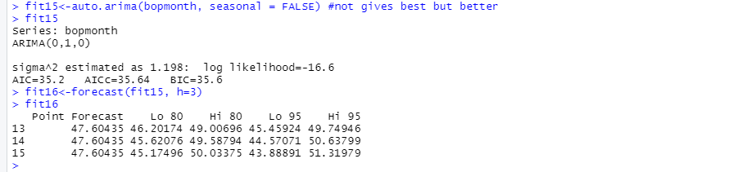
Arima on monthly Data
Forecasted value is 47.60

Slide 38
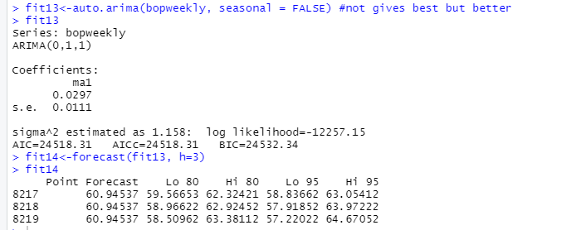
Arima on weekly Data
Forecasted value is 60.94

Slide 39
accuracy(fit11)
ME RMSE MAE MPE MAPE MASE ACF1 Training set 1.398272 14.34716 9.485248 0.5212606 20.60073 0.9697544 0.06795888
> accuracy(fit13)
ME RMSE MAE MPE MAPE MASE ACF1 Training set 0.005004031 1.07578 0.6820189 -0.0109987 1.582671 0.9998689 -0.0002952425
> accuracy(fit15)
ME RMSE MAE MPE MAPE MASE ACF1 Training set -0.04529181 1.047869 0.848753 -0.1205502 1.843708 0.921025 0.3788144
Based on the above values we can conclude that the accuracy for yearly data is better.

Slide 40
Autocorrelation
Conclusion: This acf shows there is no seasonality in data. Since the Acs of first several time lags are high then decreasing.
Autocorrelation measures the linear relationship between lagged values of a time series .
There are several autocorrelation coefficients, depending on a lag length.
The bar in the ACF indicates the autocorrelation, with values between -1 and 1.
The first bar indicates how successive values of y relate to each other.
The second bar indicates how y values two periods apart relate to each other.
Bop2 : Yearly plot
Bop3 : Monthly plot
Bop1: Weekly plot

Slide 41
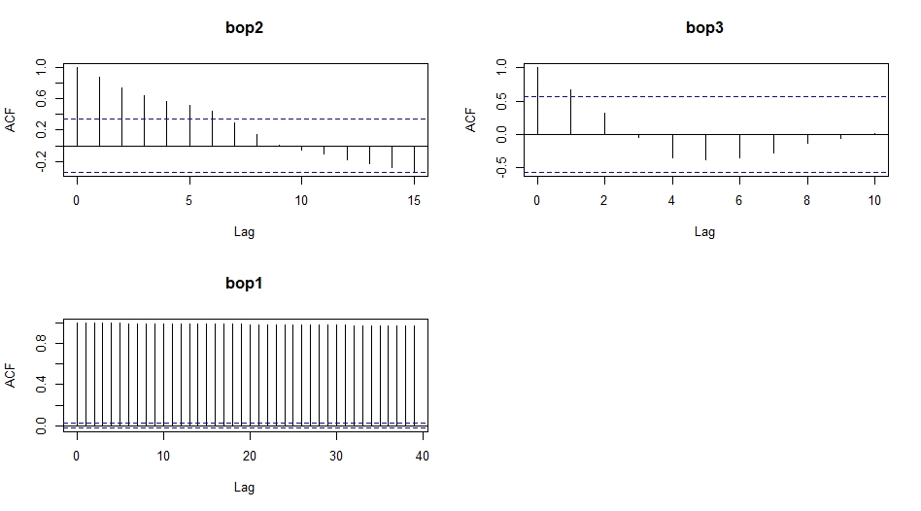

Slide 42
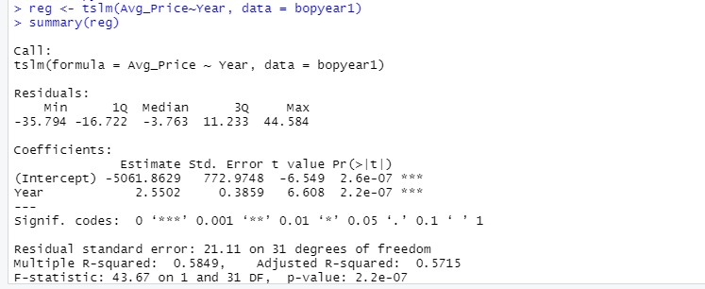
REGRESSION:
Regression output for yearly data:

Slide 43
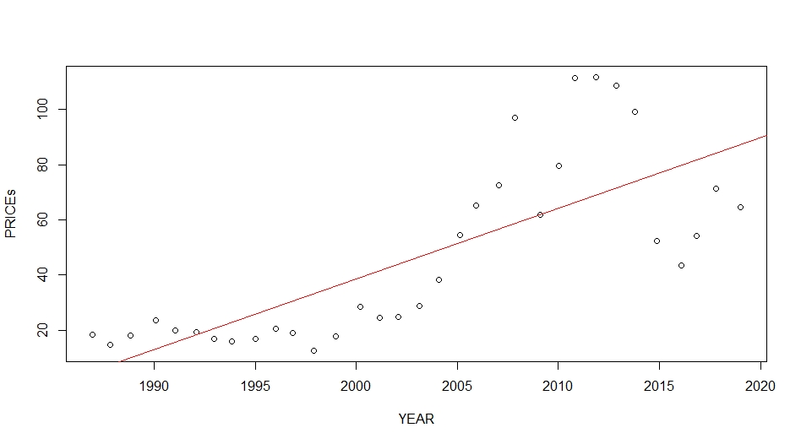
Regression line for Prices v/s Year

Slide 44
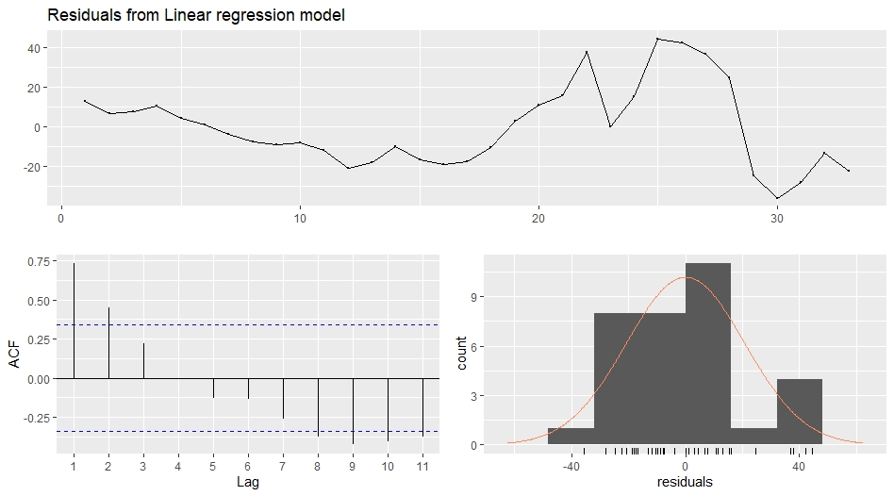
Residuals for Average price v/s Year

Slide 45
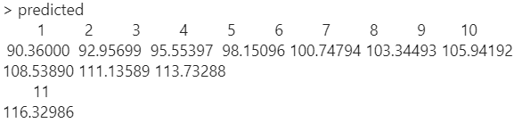
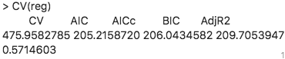
Predicting values for the next 10 years

Slide 46
CONCLUSION
Considering Simple Forecasting Method and ARIMA
Drift Method is best to use for weekly and monthly data.
Whereas ARIMA is best to use for yearly data.

